Slide 1

UNSUPERVISED MACHINE LEARNING
2nd TYPE OF MACHINE LEARNING

Slide 2
Unsupervised Machine Learning
Unsupervised Learning can be thought of as self-learning where the algorithm can find previously unknown patterns in datasets that does not have any sort of labels.
Unsupervised learning is a type of machine learning in which models are trained using unlabeled dataset and are allowed to act on that data without any supervision.

Slide 3
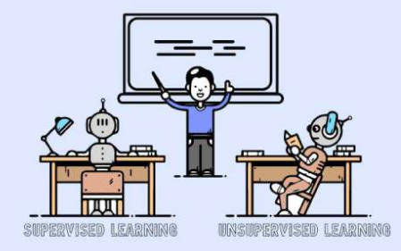
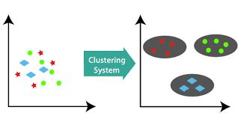
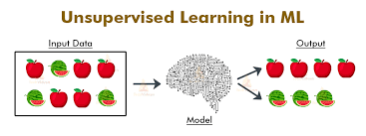
Unsupervised Learning

Slide 4
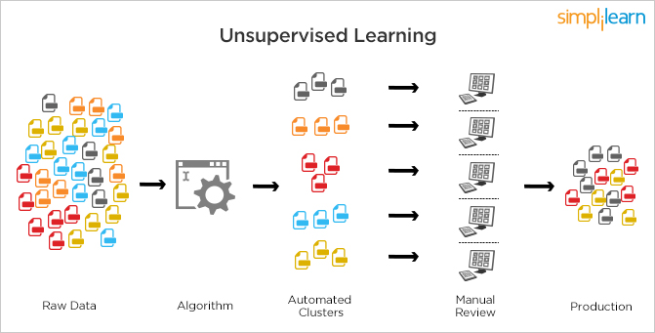

Slide 5
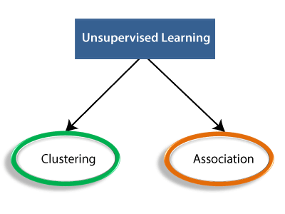

Slide 6
Clustering
Clustering is the process of dividing the datasets into groups, consisting of similar data-points.
Points in the same group are as similar as possible
Points in different group are as dissimilar as possible

Slide 7
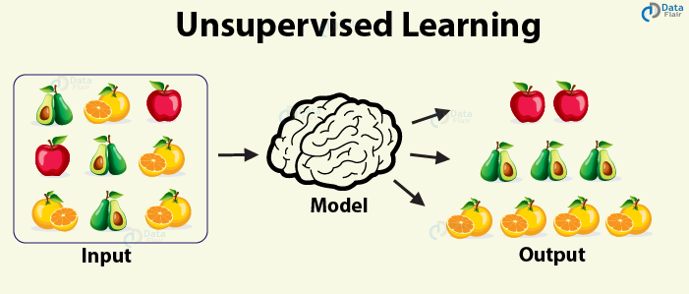

Slide 8
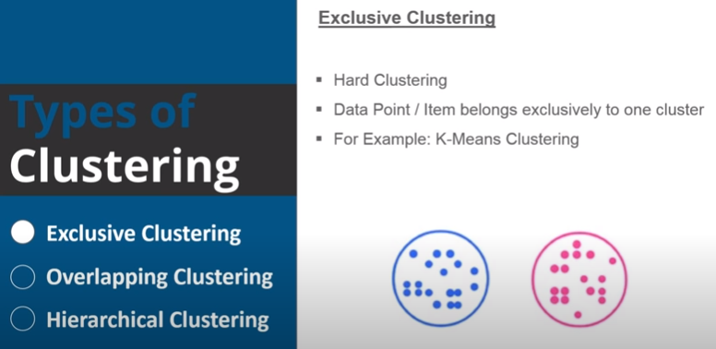
Types of Clustering

Slide 9
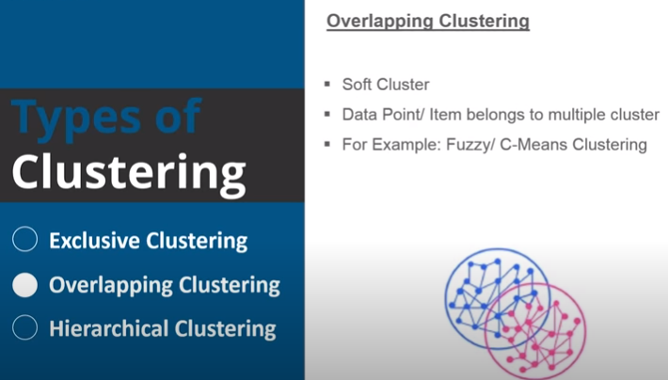
Types of Clustering

Slide 10
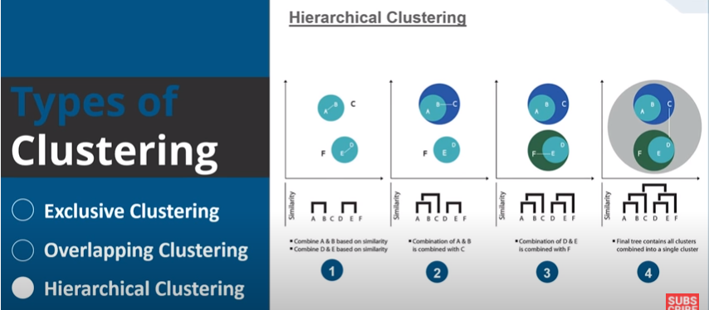
Types of Clustering

Slide 11
K-Means Clustering
K-Means is a Clustering Algorithm whose main goal is group similar elements or data points in to a cluster.

Slide 12
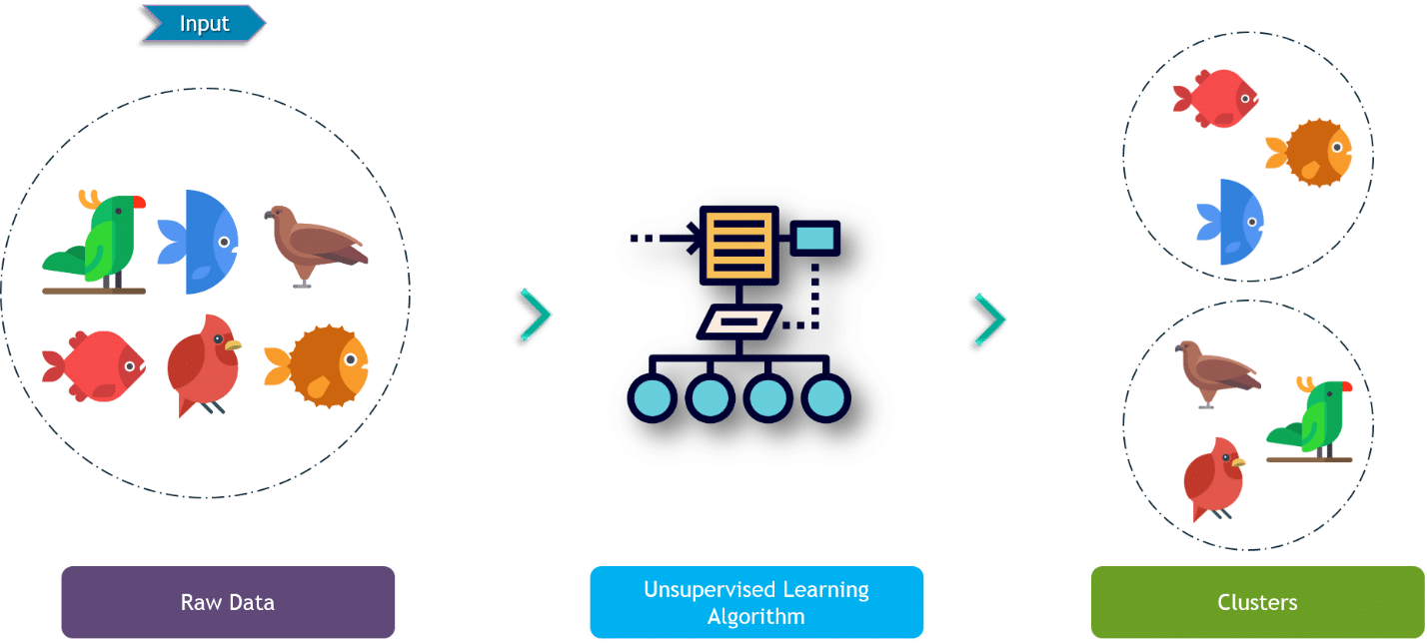

Slide 13
Thank You
Ranganayakulu

